Slide 1
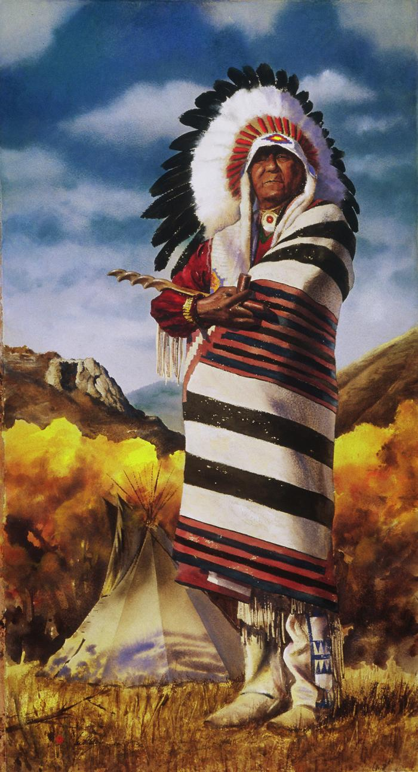
Colorado Pioneers; Ute Elder (2004.1.1)

Slide 2
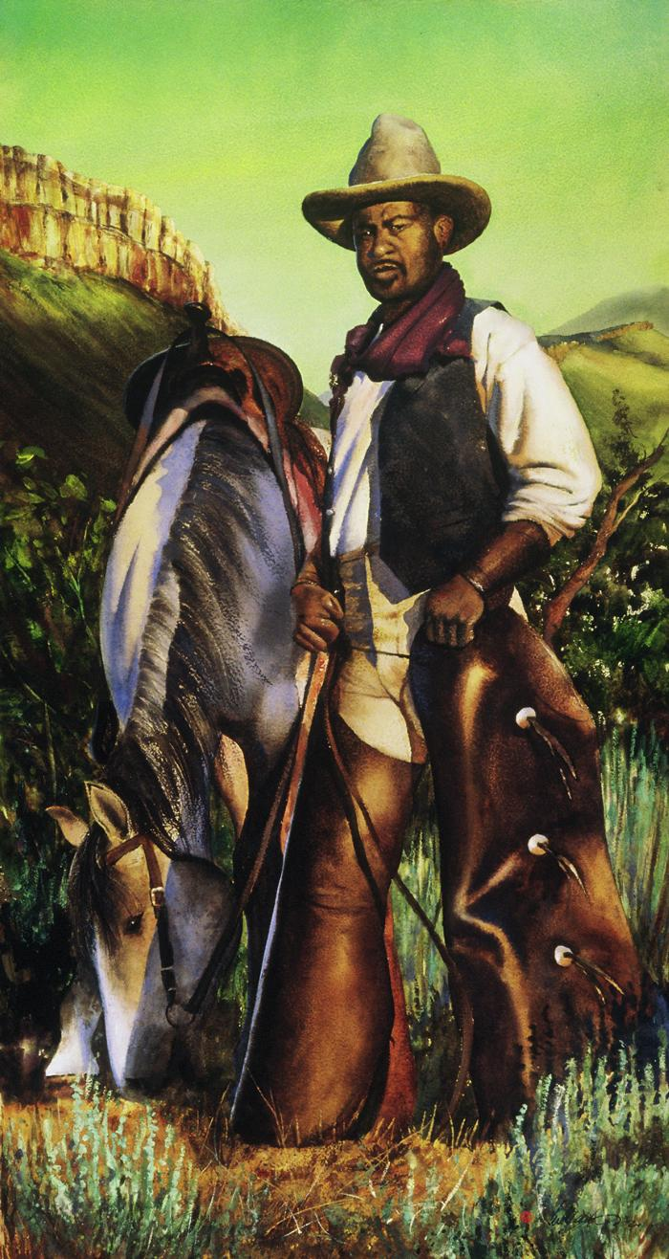
Colorado Pioneers; Cowboy (2004.1.2)

Slide 3
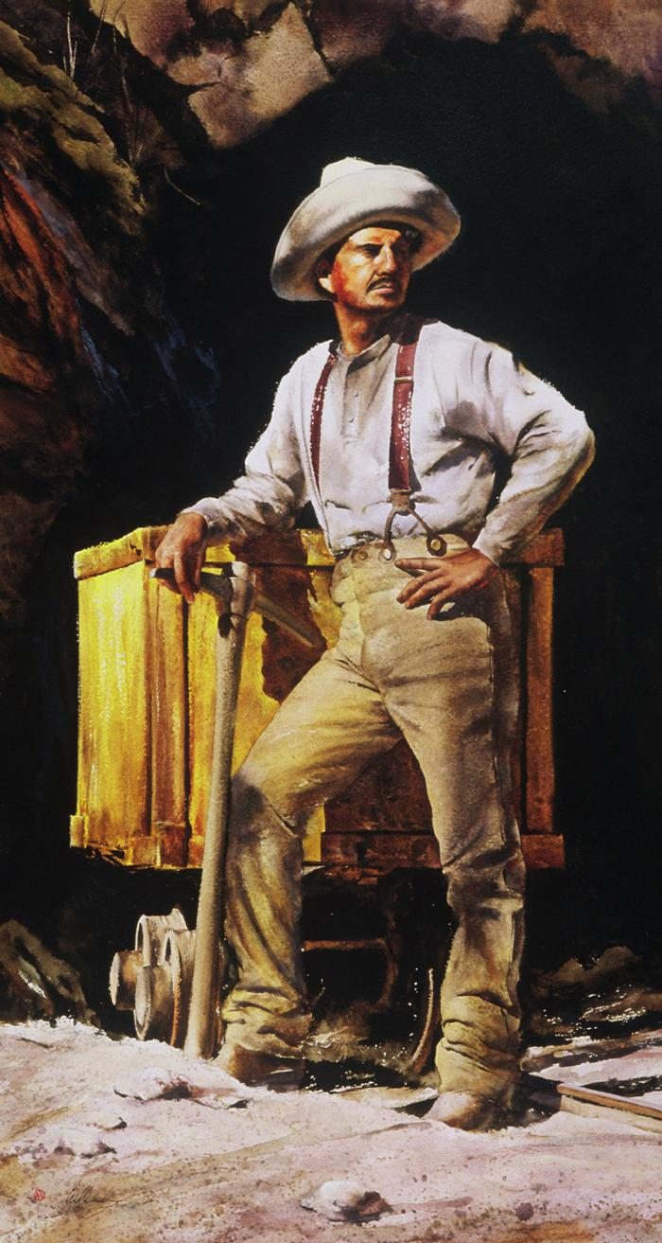
Colorado Pioneers; Miner (2004.1.3)

Slide 4
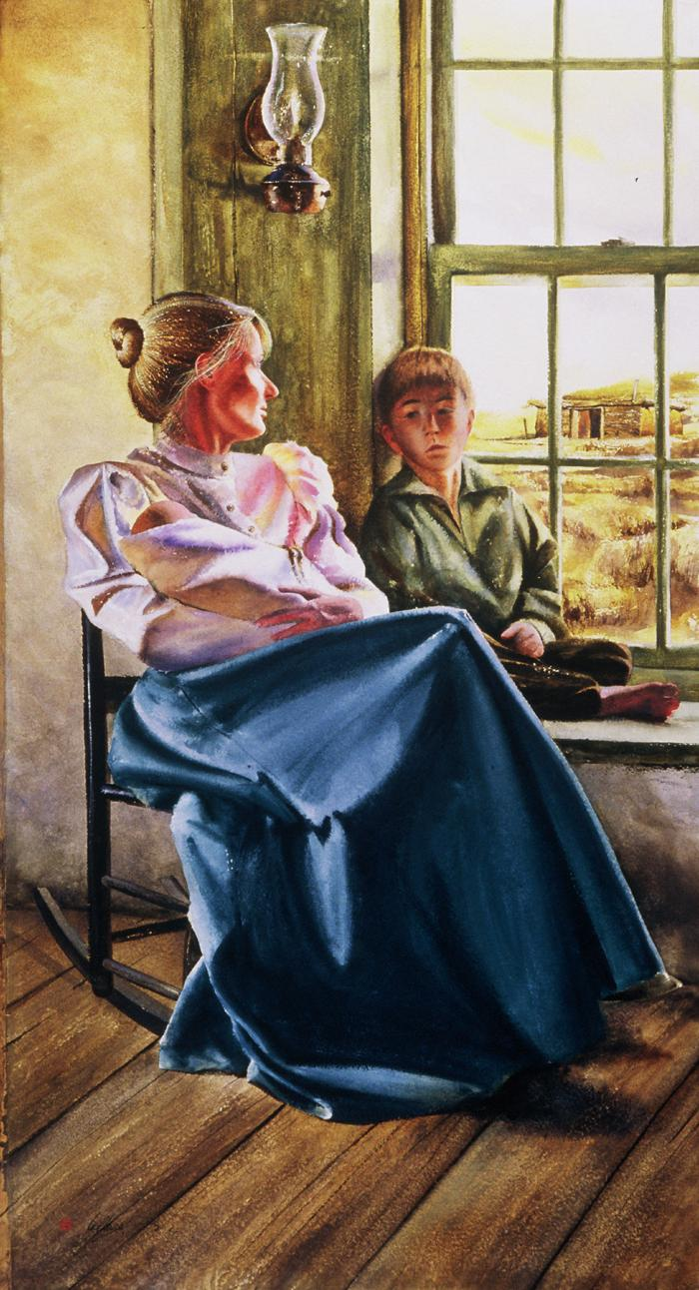
Colorado Pioneers; Mother and Child (2004.1.4)

Slide 5
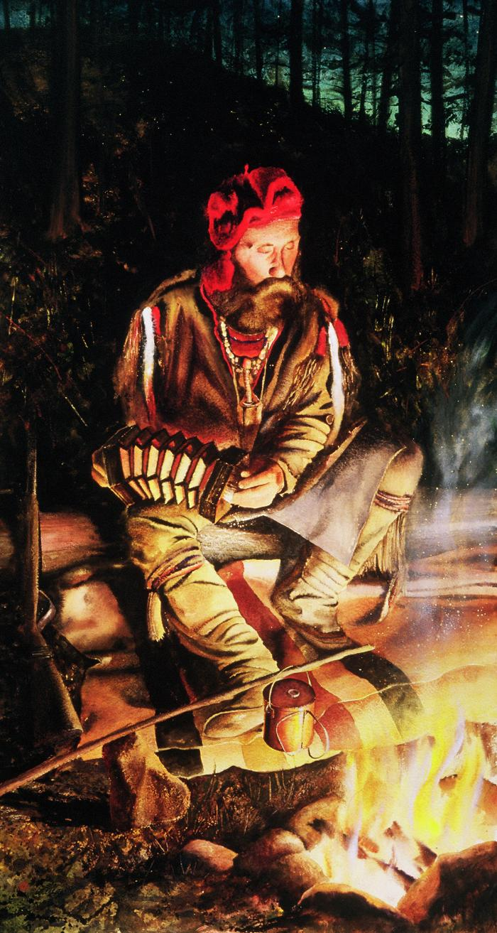
Colorado Pioneers; Trapper (2004.1.5)

Slide 6
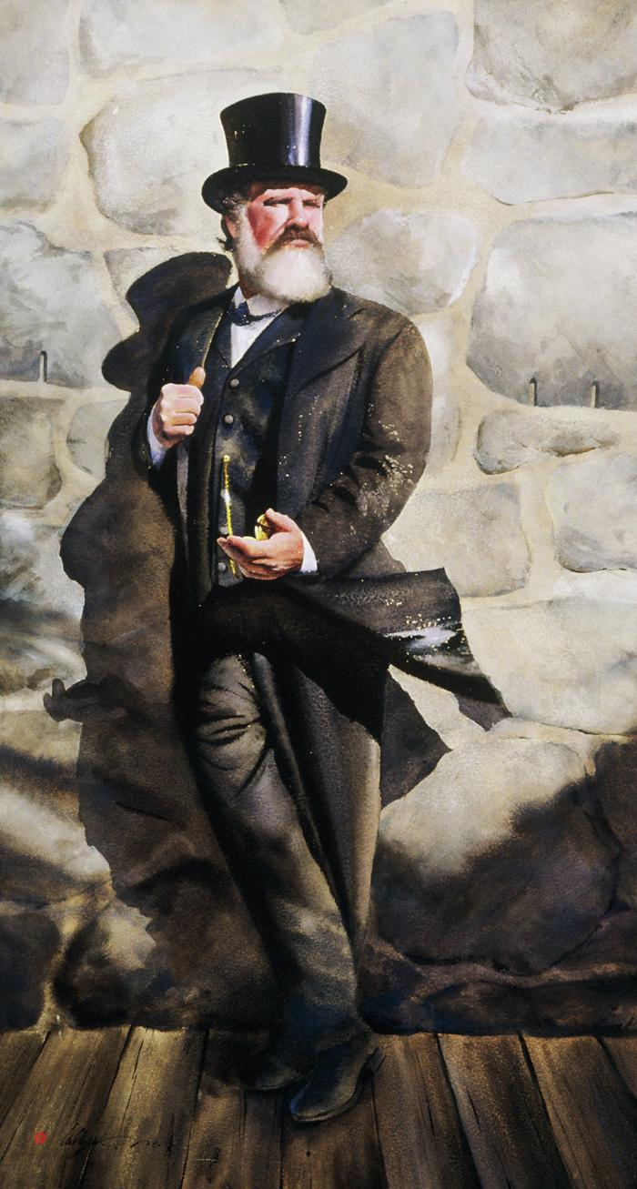
Colorado Pioneers; Merchant (2004.1.6)

Slide 7
Laughing Escalator (2004.4.1)
Visitors descending an escalator into the ballroom pre-function area encounter an unexpected serenade of laughter mysteriously rising from beneath their feet. Recorded laughs come up through the small cracks between steps, with a different voice heard every eight feet of the ride. Inside the escalator, a 4-channel sound system broadcasts a call and response volley of laughter between the speakers. The resulting open-air mix of sound creates a continually changing pattern of rhythms constructed from laughter.

