Slide 1
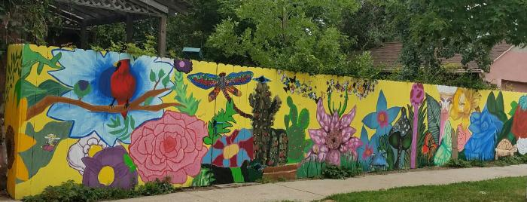
A Wall Through La Alma (UAF. 2016.10)
Art Street Mural created by youth in neighborhood

