Slide 1
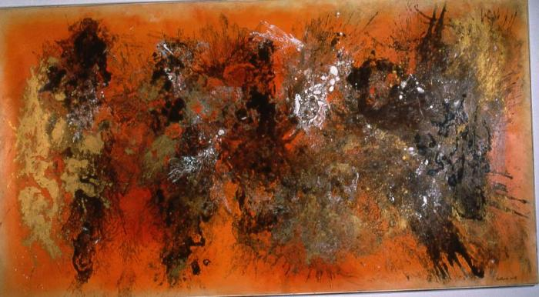
The Burmese Nebula (1961.3.1)
Abstract painting by Vance Kirkland.

