Slide 1
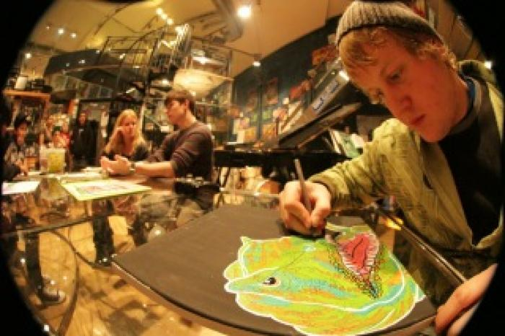
Absolute Family After School Graffiti Session (UAF.2012.11)
Afterschool Graffiti Sessions with youth

