Slide 1
Sun Spot (2011.4.1)
Sun Spot is a multi-piece artwork for Denver’s new Municipal Animal Shelter at the South Platte Campus. The primary piece is a 25’-tall iconic dog sculpture located at the southeast corner of the site, adjacent to the South Platte Trail and visible from Interstate-25. The form of the dog is an amalgam of many different dogs, in effect becoming “every dog.” Its pet-like, “sitting dog” pose expresses a friendly, playful, and welcoming nature. The sculpture is made from a structural steel skeleton overlaid with stainless steel mesh that is then covered with more than 90,000 individual stainless steel pet tags. The accumulation of pet tags is a symbol of the thousands of pet adoptions that occur at the shelter every year. In addition to metaphoric meaning, the pet tags will have phenomenological effects. The tags hang from hooks and flutter in the breeze. The second piece of Sun Spot is a suspended sculpture located in the front lobby and adoption waiting room of the Animal Shelter. Its principal ele­ment is a 6’-diameter collar, sized to fit the exterior dog sculpture. Hanging from the collar is an oversized pet tag etched with the name “Sun Spot.” The collar is made from blackened steel and gold aluminum, with stainless steel buckle and spike details. Decorative patterns cut and etched into the collar are derived from the leaves and berries of the plants used around the dog sculpture. The stainless steel chain used to suspend the collar from the ceiling references dog leashes. Hanging from the lower side of the collar are approximately 100 individual strands of chain, ranging in length from 30” to 66”. Every time a pet is adopted from the shelter the new owner will be given an opportunity to have a pet tag engraved with the name of the pet and date of the adoption, and then attached to a link of the chain. While the tags used on the dog sculpture are all stainless steel circles, the tags for the collar will be a variety of shapes and colors. Over the years the sculpture will accumulate more and more tags, becoming a communal gesture of animal stewardship. The sculpture is designed to accommodate up to 7,000 tags. The final element of the artwork is another set of approximately 50 pet tags, subtly marking native plants along the South Platte Trail west of the South Platte Campus. These tags are engraved with botanical and common plant names. Using pet tags to “name” the plants links their value with the societal value placed on pets. The artists hope that the tree tags may eventually inspire an “adopt-a-tree” program, whereby non-native plants are replaced with native plants in an effort to regenerate the riparian plant zone similar to how the adjacent brownfield has been reclaimed by the municipal facility, and linking back to the pet adoptions that occur at the Animal Shelter. The three pieces of Sun Spot each work on an individual basis but are tied together by their common use of pet tags as an inspirational material that has a direct link to the function of the Animal Shelter.

Slide 2
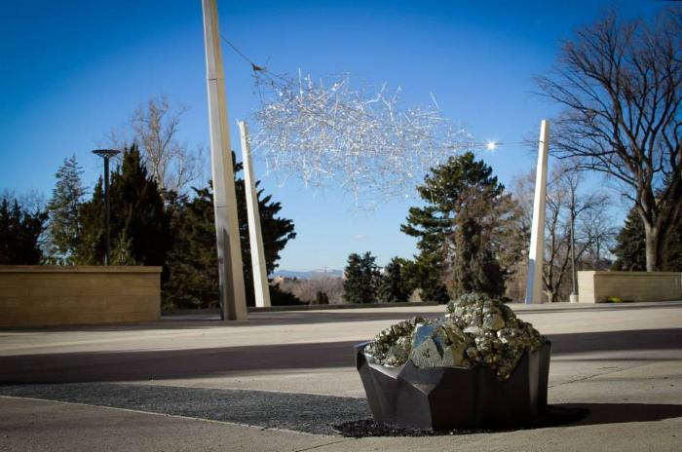
Iridescent Cloud (2014.2.1)
Art for the south arrival plaza at the Denver Museum of Nature and Science’s new educational wing draws on museum exhibits about light, optics and minerals, combining them with the dynamic Colorado sunlight to create an embodied aesthetic experience. The main feature, “Iridescent Cloud,” is a suspended sculpture built from hundreds of tetrahedral clear acrylic prisms woven into a web of mirrored stainless steel rods in a design loosely derived from the molecular structure of hexagonal quartz crystals. As sunlight shines on the prisms, they sparkle with iridescent colors that move across the sculpture as one walks around it. Leading up to the plaza is a 270 foot-long glass lithocrete paving arc that transitions through all the colors of the visible light spectrum and terminates in a pyrite specimen set in a blackened bronze “pot of gold,” a treasure for children to discover at the end of the rainbow.

Slide 3
Luminous Wind (2020.4.1)
Luminous Wind is a 27’ tall sculpture inspired by innovation, energy and the natural environment. Constructed from environmentally activated materials, the 952 prismatic clear acrylic rods within the piece reflect and refract sunlight during the day and radiate out from a stainless-steel geodesic sphere that is set on a tripod of stainless-steel columns. At night, each rod is illuminated by an individually programmable color-changing LED node, resulting in a mosaic of shifting light colors and patterns to create a myriad of spectacular dynamic and vivid nighttime effects. A different moving light show each night of the week cycles through the sculpture, while holidays are marked by special colors and programs. Additionally, the design incorporates a wind sensor that triggers an increase/decrease to the light movement, creating a barometer that visualizes and broadcasts wind patterns. Luminous Wind creatively draws connections between Peña Station NEXT, a technologically infused master-planned Smart-City, Panasonic technology, and Denver’s former mayor, Federico Peña, the namesake of both Peña Boulevard, which leads to the airport, and the transit station situated on airport property. The artwork includes dedication plaques with quotes from Peña who was elected Mayor of Denver in 1983, making him the city’s first Hispanic mayor, and who led the efforts to replace Denver’s Stapleton International Airport with Denver International Airport (DEN). He also served as the U.S. Secretary of Transportation and U.S. Secretary of Energy.

