Slide 1
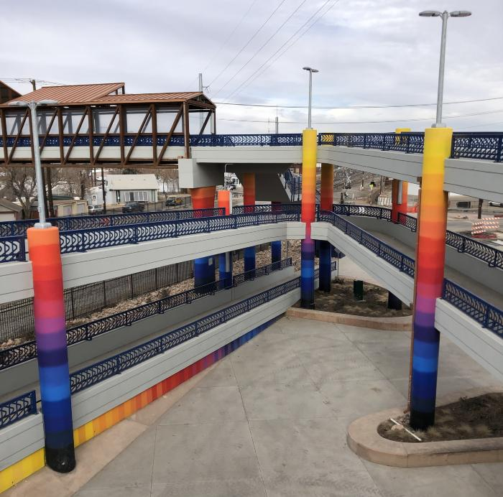
Bridging the Community (2020.7.1)
This brightly colored mural installed on 32 columns and several walls of the 47th and York Bicycle and Pedestrian Bridge, Bridging the Community is modeled after Anthony Garcia, Sr.'s continuing goal of bringing communities together in a positive way. The artwork references the residents of the surrounding area by utilizing a vibrant array of colors or “cultures.” The chromatic blending of the paint colors symbolizes the importance of communities working, or "blending”, together to prosper in a brighter future. The work also references the many colors or “identities” it takes to create a vibrant community as well as the inspirational "unifying force,” such as art, to bring it all together.

