Slide 1
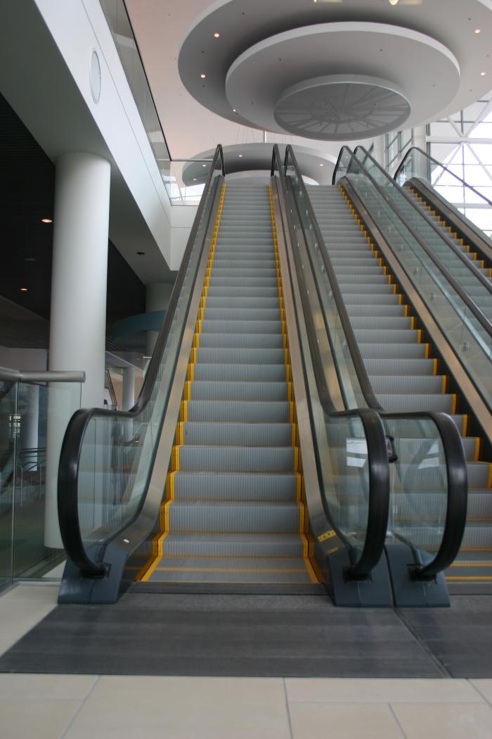
Laughing Escalator (2004.4.1)
Visitors descending an escalator into the ballroom pre-function area encounter an unexpected serenade of laughter mysteriously rising from beneath their feet. Recorded laughs come up through the small cracks between steps, with a different voice heard every eight feet of the ride. Inside the escalator, a 4-channel sound system broadcasts a call and response volley of laughter between the speakers. The resulting open-air mix of sound creates a continually changing pattern of rhythms constructed from laughter.

Slide 2
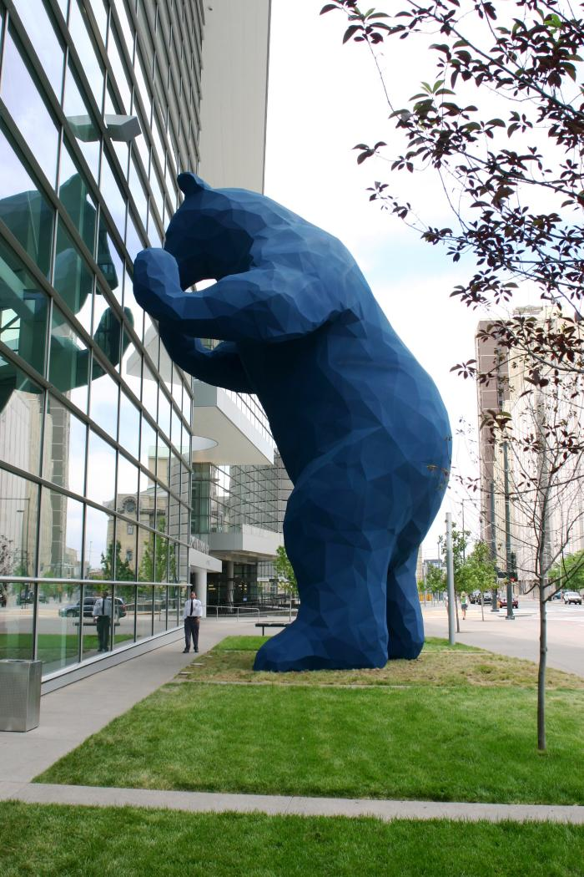
I See What You Mean (2005.1.1)
Colloquially known as “The Big Blue Bear,” the artist has described "I See What You Mean" as a stylized representation of native fauna. As the bear peeks inside the enormous facility at the conventioneers, displacement and wonder pique curiosity and question a greater relationship of art, technology and whimsy.

