Slide 1
The Stream Rises Above the Fountain (2014.5.1)
The artwork is installed on the south wall of the Montbello Recreation Center. The work is 32 feet tall, 60 feet wide. The two dimensional aluminum and ceramic fountain symbolizes the positive and healing forces at work in the community. There are eight giant brightly glazed figures (seven animals and one human) tumbling around in the vertically plunging flow of aluminum. Through a series of free hands-on workshops at the Montbello Recreation Center, the community created additional tiles reflecting positive personal and collective expressions of Montbello. These tiles were incorporated into the final artwork.

Slide 2
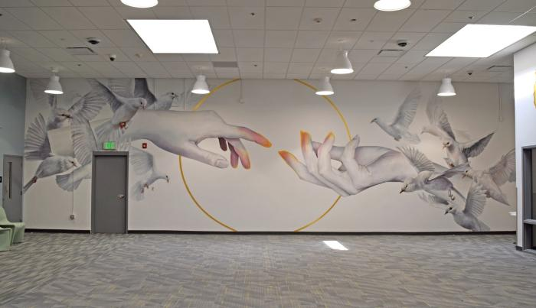
The Journey (2024.2.1)
THE JOURNEY is an installation of three murals within the Denver County Jail&#39;s Visitors&#39; Room. Intended to support the much-needed connection between people serving their short sentences and their loved ones, these murals symbolize our interconnection and unity, hope for the future, and growth.

