Slide 1
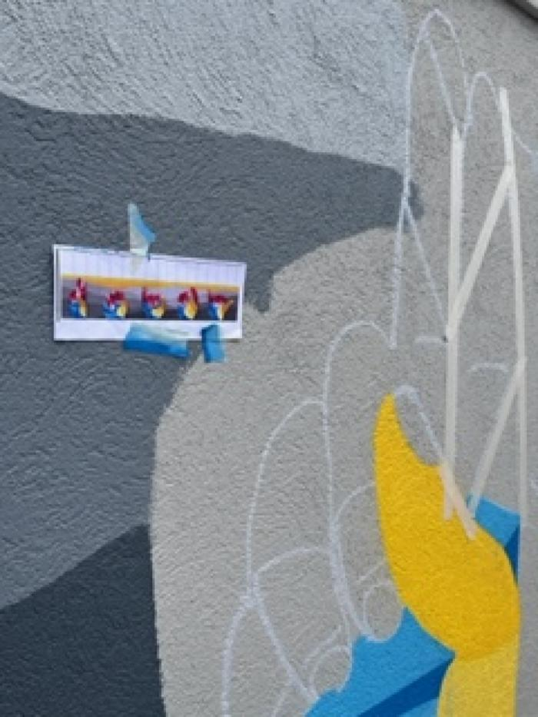
Unity (UAF.2022.3)
This mural, funded through Denver Public Art&#39;s Urban Arts Fund, features the word "unity" in American Sign Language and was inspired by the work of Nancy Rourke. Access Gallery works with artists with disabilities to open doors to creative, educational and economic opportunities. [vimeo src=https://player.vimeo.com/video/739070835]

