Slide 1
[BLANK] (IN PROGRESS_SLOAN'S LAKE)

Slide 2
[BLANK] (IN PROGRESS_NATURE PLAY)

Slide 3
[BLANK] (IN PROGRESS_MOTHERSHIP Ext.)

Slide 4
[BLANK] (IN PROGRESS_BEHAVIORAL HEALTH )

Slide 5
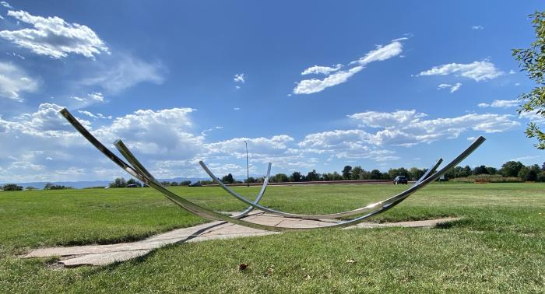
Bows (2020.2.1)
Artist Patrick Marold used stone and steel to create arching lines of light and space, complementing and enhancing how the public sees and engages with the landscape. With additional funding from The Park People, this artwork at Cranmer Park was created to enhance the panoramic perspectives of the front range and sky. Located on the eastern edge of the park, trees line public passageway from the neighborhood and frame the artwork for visitors. Artist&#39;s Statement: My intention with "Bows" was to draw arching lines of reflected light through space, complementing, and enhancing how the public sees and engages with the landscape. Cranmer Park is a uniquely situated public space located in the Hilltop neighborhood of Denver, where the viewer can experience wide panoramic perspectives of the front range and sky. The "Bows" are located on the eastern edge of the park, where there are trees and a public passageway from the neighborhood into the park, framing the artwork and particular western perspectives. The eastern public stretches of lawn are ideal for weekly volleyball and croquet tournaments, sunbathing and marching band practice. The art is intended to encourage the people of Denver to make way to this often overlooked end of Cranmer Park and to crank their boom boxes in the name of peace, love and equality.

Slide 6
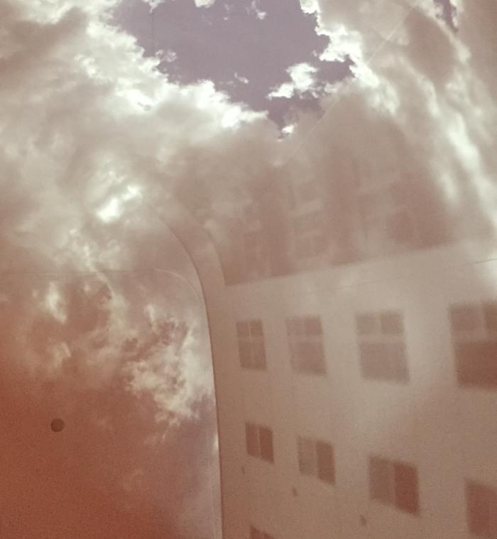
clerestory (2016.6.1)
clerestory is an architecturally integrated optical work that brings views of the sky into a library’s vaulted Storytime Tower, a place used for storytelling in the children’s collection. When the outdoor sky is bright, the vault is illuminated by images of the sky, clouds, treetops and neighboring building. The imagery changes constantly, a direct live projection of what is happening immediately outside. The projection is natural, with no electronics or power source other than the light outside. It is bright enough to be seen even with the ambient lights of the library. [vimeo src="https://player.vimeo.com/video/363426849"]

Slide 7
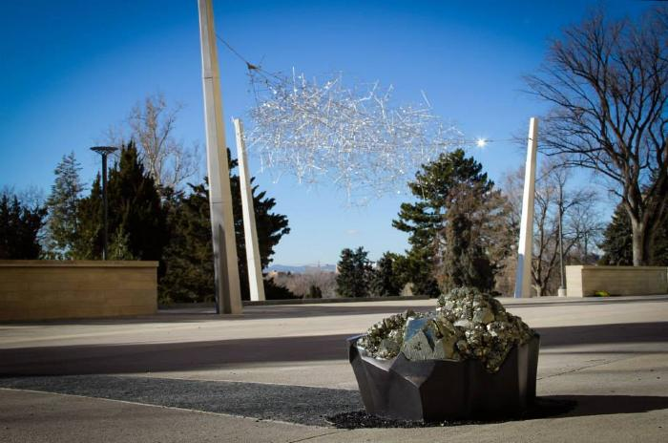
Iridescent Cloud (2014.2.1)
Art for the south arrival plaza at the Denver Museum of Nature and Science’s new educational wing draws on museum exhibits about light, optics and minerals, combining them with the dynamic Colorado sunlight to create an embodied aesthetic experience. The main feature, “Iridescent Cloud,” is a suspended sculpture built from hundreds of tetrahedral clear acrylic prisms woven into a web of mirrored stainless steel rods in a design loosely derived from the molecular structure of hexagonal quartz crystals. As sunlight shines on the prisms, they sparkle with iridescent colors that move across the sculpture as one walks around it. Leading up to the plaza is a 270 foot-long glass lithocrete paving arc that transitions through all the colors of the visible light spectrum and terminates in a pyrite specimen set in a blackened bronze “pot of gold,” a treasure for children to discover at the end of the rainbow.

Slide 8
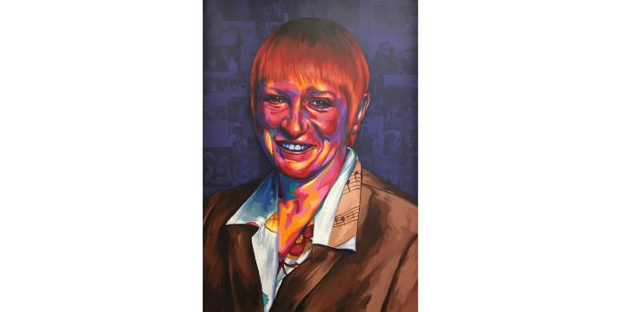
Portrait of Carla Madison (2018.1.1)
From a City of Denver news release (April 6, 2011): "Denver City Council lost one of their most vibrant members as District 8 Councilwoman Carla Madison lost her battle with cancer late Tuesday. Madison was elected in June 2007 and known for her bold style and outlook on life. She was passionate about neighborhoods and strengthening the community spirit of her East-Denver district. An ardent environmentalist, Carla was often seen riding around town on her cruiser bike or jetting to Council meetings on her orange scooter, sporting a colorful hat and a warm smile. In her work as a Councilwoman, she carried on the District 8 community traditions of the Hiawatha Davis Senior Luncheon and the King Trimble Tea. She started her own tradition, hosting an old-fashioned Ice Cream Social in City Park each summer, complete with historic costumes and activities. Adoption of the City's new zoning code in 2010 was due in large part to her efforts to shepherd the massive overhaul through the political process, while being attuned to the needs of Denver's business and neighborhood organizations." Statement from Denver Mayor Guillermo (Bill) Vidal: "Carla was a dear friend who always had a warm smile and a kind word to share, and in turn, her positive energy and attitude brought happiness to others. She was a true and tireless champion for the many and diverse issues brought forward by her constituents in Council District 8, as well as a steadfast supporter of city-wide economic development and an outspoken advocate for the arts. Never too busy to take a moment to discuss an issue or a concern, Carla was known for her kind and selfless spirit. Carla will be greatly missed at City Hall but never forgotten in our thoughts. May peace be with her loved ones at this time of their loss." Artist's statement: "Being able to work on the Carla Madison portrait for her recreation center is a true honor and humbling experience. It was great to be able to meet her husband and sister and learn more about Carla’s adventurous life and colorful personality. After hearing about many of the wonderful things Carla did in her life, I feel even more excited to have the opportunity to showcase that through my work."

Slide 9
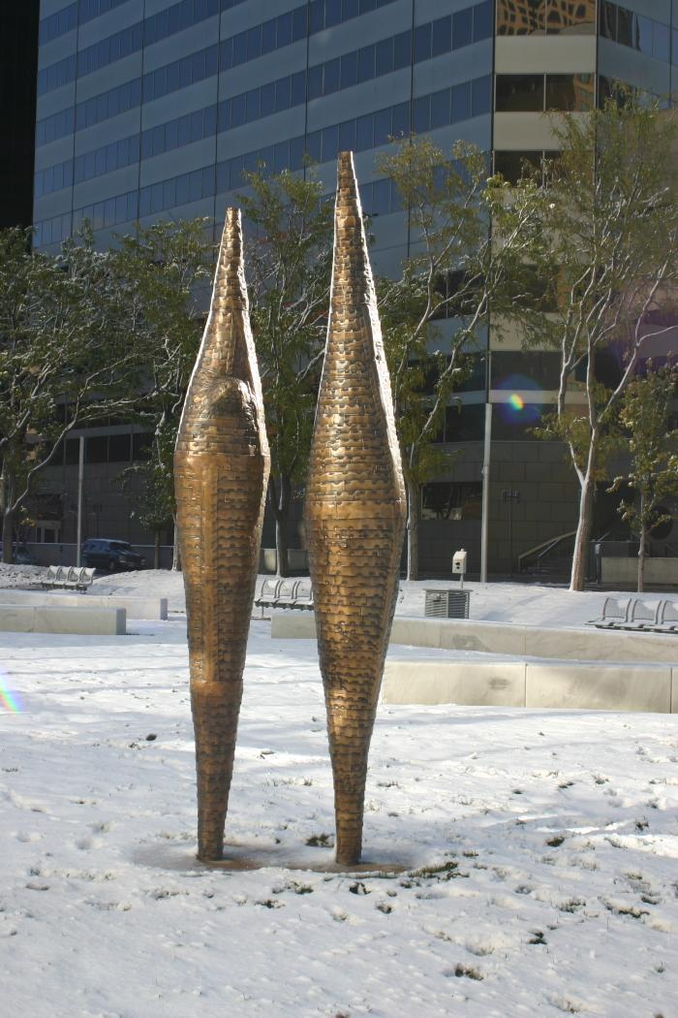
Promenade (2006.4.1)

Slide 10
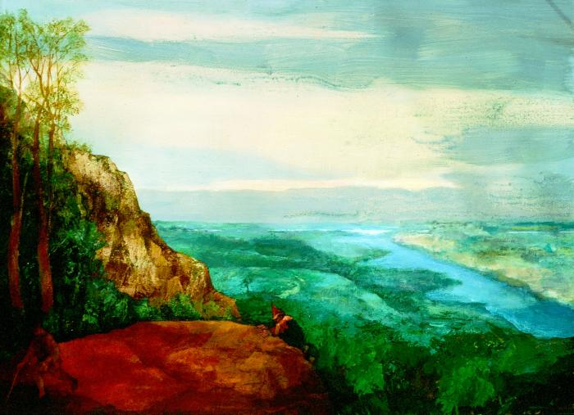
Pursuit (2014.7.1)

Slide 11
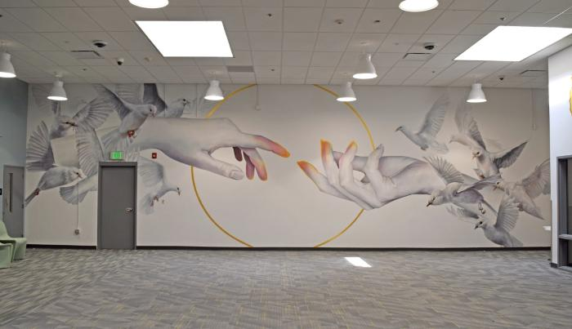
The Journey (2024.2.1)
THE JOURNEY is an installation of three murals within the Denver County Jail&#39;s Visitors&#39; Room. Intended to support the much-needed connection between people serving their short sentences and their loved ones, these murals symbolize our interconnection and unity, hope for the future, and growth.

Slide 12
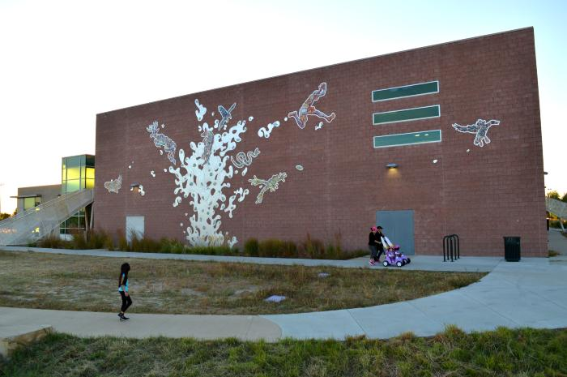
The Stream Rises Above the Fountain (2014.5.1)
The artwork is installed on the south wall of the Montbello Recreation Center. The work is 32 feet tall, 60 feet wide. The two dimensional aluminum and ceramic fountain symbolizes the positive and healing forces at work in the community. There are eight giant brightly glazed figures (seven animals and one human) tumbling around in the vertically plunging flow of aluminum. Through a series of free hands-on workshops at the Montbello Recreation Center, the community created additional tiles reflecting positive personal and collective expressions of Montbello. These tiles were incorporated into the final artwork.

Slide 13
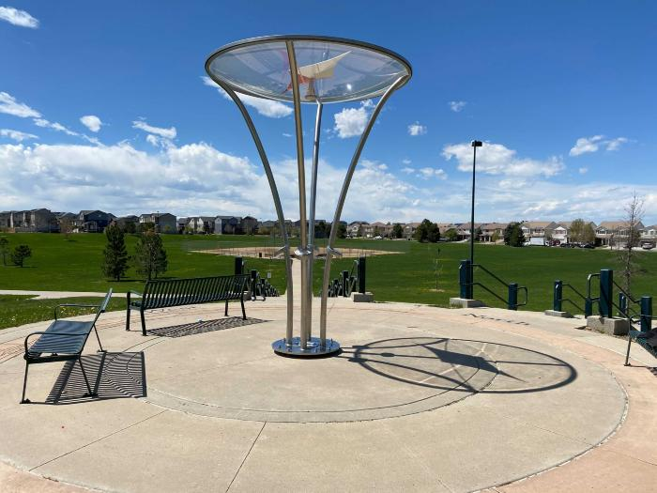
True West (2021.5.1)
“True West” by Nick Geurts and Ryan Elmendorf of yetiweurks (Denver, CO) is an 11′ stainless steel, interactive, touch-based sculpture at Green Valley Ranch Town Center Park designed to inspire wonder and collaborative playfulness. This immersive, participatory art is comprised of a larger-than-life overhead compass, with its needle pointing west. Participants will see four stainless steel pad elements, each attached to one of four columns. Once a visitor approaches or touches one of the pads, the compass needle will start turning, drawn in the pad’s direction. Once the participant retreats or leaves the area, the needle slowly finds its way back to west. “True West” reflects artists' passions to invoke a sense of discovery, play, wonder and learning for children and adults alike.

Slide 14
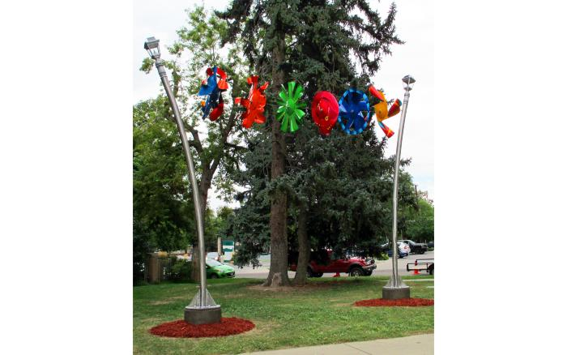
Upper Main Street Clothesline (2014.4.1)
This sculpture was built with six kinetic discs suspended on a steel cable between two swaying upright poles. The discs were fashioned from 22-gauge mild steel and fitted bearings with finishes ofe brightly colored powder coats and enamel paints. The support poles were fabricated in polished stainless steel and rolled to create an effortless sway. The mix of kinetic movement, color and bouncing patterns reflects the ‘moving energy” of Colfax Avenue – it’s commerce, culture, events, townships and people. In a historical consideration, US Hwy. 40 (Colfax Avenue) is a clothesline connecting commerce, culture, events, townships and people. The construction of US Highway 40 meant that Denver continued to grow as the highway became a major corridor from east to west. It ensured that Denver would have the benefit of being a major crossroad. Colfax Avenue is an epicenter of a “moving culture” filled with automobiles, bikes, pedestrians and businesses. In its lifetime, the tide of business, gentrification and redevelopment has ebbed and flowed like the roadway’s daily traffic jams. As Colfax Avenue is a major vehicular and pedestrian thoroughfare, the sculpture was designed to be simple in nature, while still generating a bold statement. The background of evergreen trees created a strong canvas to a piece which calls to mind the neighborhood culture that is dramatically shifting with renewed energy. The sculpture dances in a whimsical fashion. Discs moving in different directions, at different speeds reflect the daily engagement of light, sound and people, going places, doing things – having a good time on Colfax Avenue.

